Slide 1

Inferring latent strategies in human decision making
*title in progress
03/22/2024
Notes:
Investigating latent states in perceptual decision-making

Slide 2
Open question in neuroscience
What factors affect how humans make decisions, and how do these factors interact?
How well do computational models of perceptual decision-making capture the underlying neural mechanisms?

Slide 3
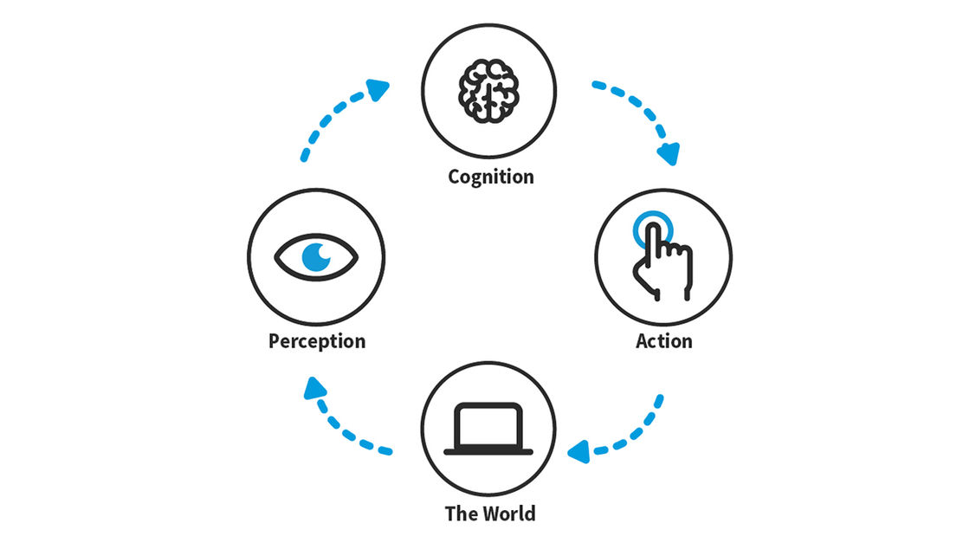
Perceptual Decision Making
Discrete or Continuous
Factor 2 – top down
Cognitive Bias
Selective Attention
Prior Knowledge
Factor 1 – bottom up
External Inputs

Slide 4
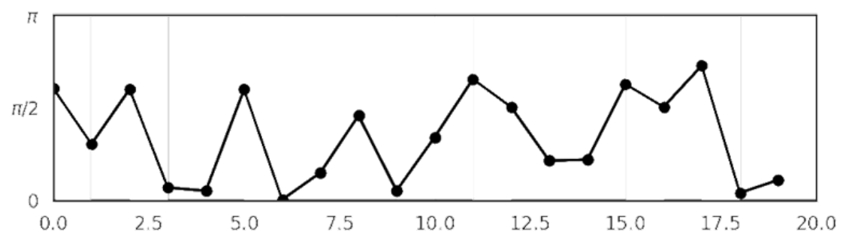
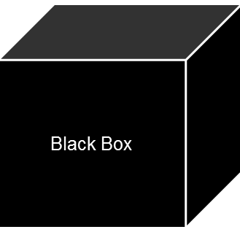
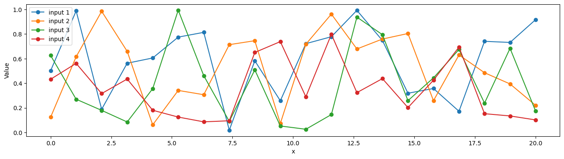
Inferring the latent mechanisms
Observation/
Decisions
Infer
p( Decisions | Covariates )
(model)
External Factors/
Covariates

Slide 5
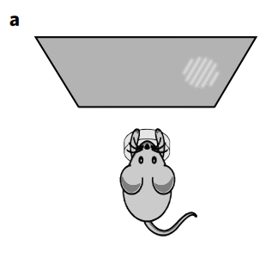
Prior research - Ashwood et al
Context:
It has been observed that mice often ‘lapse’ during behavioral experiments.
Previous explanations: inattention, motor error, incomplete knowledge of the task etc. (assumes lapses arise independently)
Ashwood shows: lapse do not arise independently but, rather, depend heavily on latent states that underlie decision-making behavior
‘lapses’: in which an observer makes an error despite the availability of strong sensory evidence
Notes:
HMM employed in a 2 alternative forced choice task in mice

Slide 6
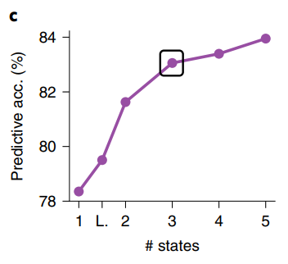
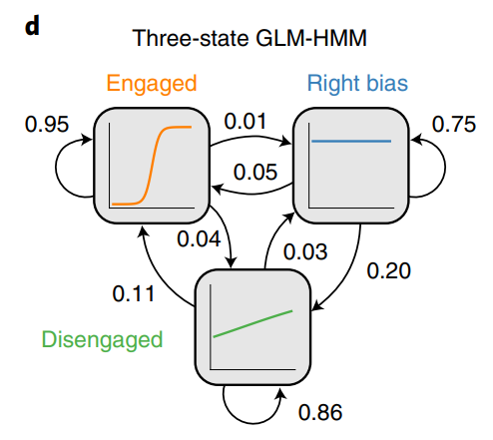
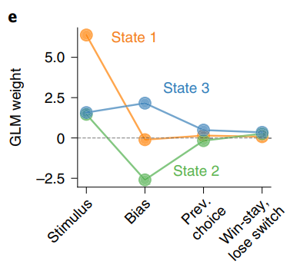
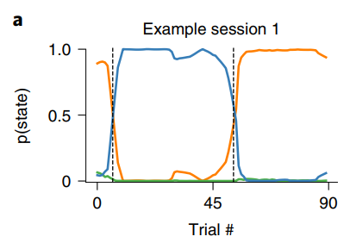
GLM-HMMs
Notes:
Plot c – predictive accuracy of the different state models
Plot d – Three state GLM HMM chosen, with the states being Engaged, right-bias and disengaged. We can see that the engaged state has the highest transition possibility
Plot e – Weights of the covariates wrt to the states. Covariates here being the stimulus, bias (an array of ones), previous choice (what the mouse chose on the previous trial), and win stay lose switch(corresponding to switching the response based on reward received).
Plot a – Probabilities of the mouse in one of the three states for the 90 trials.
Real world is ‘richer’. 2AFC task is discrete and binary; We need models that can handle continuous or multiclass observations to capture richer behaviors.

Slide 7
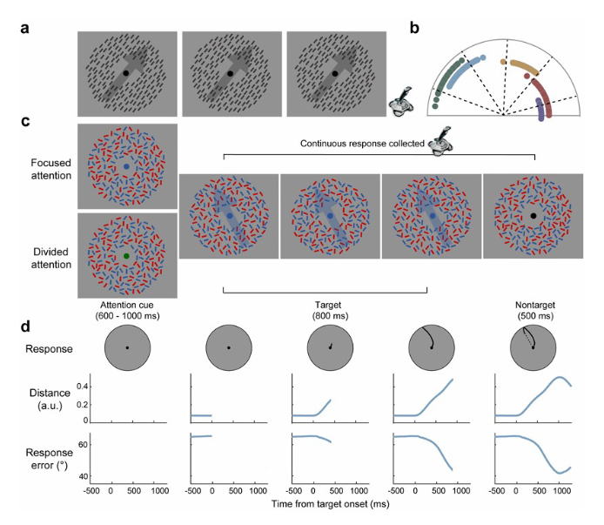
Experiment overview
Notes:
So, our experiment consisted of participant responses to an orientation variant of a random-dot motion task, such that stimulus strength (coherence levels), selective attention and expectation about target coherent orientations could be manipulated. Participants completed 4 test sessions; each consisted of practice trials, calibration trials and test trials.
Experiment started with a block of calibration trials; with 400 black bars displayed as shown without an attention cue. On each trial, 100% of the bars formed a coherent orientation in one of the five possible orientations (15-159 degrees with 36 degree increments). Participants reported the motion direction of coherent orientation using a flight simulator joystick.
For the main task, each trial began with a display consisting of a fixation point surrounded by an annulus of flickering randomly oriented 200 red and 200 blue bars. After 400-800 ms, the fixation point was replaced by an attention cue; red, blue or green on a dark grey background. Red and blue attention cues informed participants of the color of the forthcoming target orientation forming a part of the focused attention case, whereas green cue didn’t inform participants and hence they had to monitor both red and blue cars for a coherent orientation, corresponding to the divided attention case.
One color was flickered at 30 Hz the other at 40Hz for the duration of a trial. After 600-1000 ms, the red and blue flickering bars were presented for 800 ms, such that a proportion of either red or blue bars formed a coherent orientation at one of the 5 possible orientations. The remaining bars were randomly assigned to the other 4 directions. Note that the attention cue was always valid such that on focused attention trials, the coherent orientation was represented by red bars on half the trials (red attention cue) and by blue bars (blue attention cue) on half the trials. The target display was followed by a 500-ms of a display of a fixation point surrounded by randomly oriented red and blue bars. Each trial ended with a blank intertrial-interval (ITI) that lasted for 666.7-1000 ms. Participants indicated the target coherent orientation by moving the flight simulator joystick its maximal distance in a direction matching the coherent orientation. After making a response, participants turned the joystick to the center in preparation for the next trial. Responses were considered valid when they occurred in the interval between target onset and ITI offset
On each trial, we first identified the final coordinate of the joystick at maximum distance from starting point and used that coordinate to compute the final angle response on each trial (i.e., final response). We then computed an absolute error between this final response and the presented coherent orientation (i.e., final response error) on each trial. Any trials with missed responses and responses that were too early were discarded from further analysis.

Slide 8
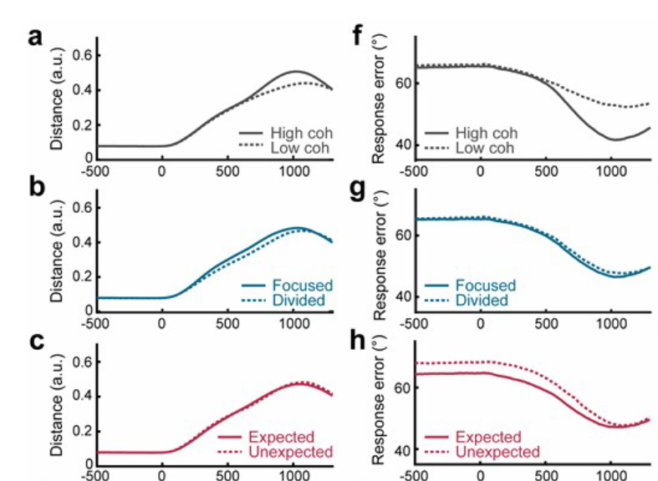
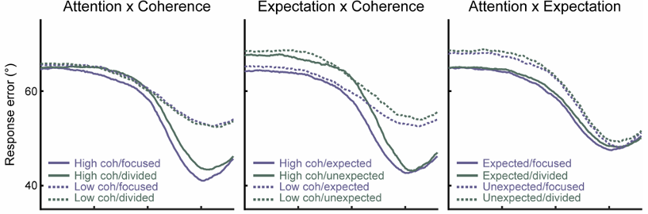
Analysis
Coherence Level
Expectation
Attention
Notes:
We then examined the impact of coherence level (low/high), attention (focused/divided), and expectation (expected /unexpected) on response trajectories and response errors across time. Response trajectory is a measure of a temporal integration of sensory information from the onset of target presentation leading up to a decision choice. Response trajectory was computed as a cumulative distance the joystick was moved from the center across time
Top-down parameters – Expectation and Attention
Bottom-up – Coherence level
Target aligned response trajectories and target aligned response errors plotted from the onset of coherent orientation (0ms) to 1000ms after onset. Response trajectories and errors were plotted as a function of orientation coherence (high/low); as a function of attention (focused/divided); as a function of expectation (expected/unexpected).
Focused attention led to a greater amplitude of response trajectories in comparison to divided attention from 266.7 to 966.7 ms after target onset (resampled p < 0.05; b). Response trajectories were not modulated by manipulations of expectation (c). Response errors were lower when coherent orientation was presented at a high coherence than at a low level from 541.4 to 1300 ms after target onset and from -225 ms before peaked response to 250 ms after peaked response

Slide 9
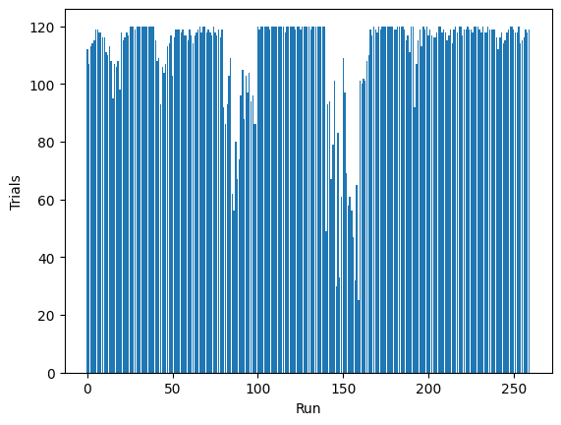
Experiment overview
Calibrated Target Angle
Coherence Level
Focused/Divided Attention
Expected Orientation
Covariates
Final response Angle
Emissions
Resampled, in-order, without replacement
* 120 * 260
* 20 * 1300
trials
sessions
trials
sessions
80:20 train:test

Slide 10
Key modeling constraints
Circular Data
Continuous Emissions
Sequences/Time Series
Weights can change over time/ “Switching Strategy”
p( | )
Calibrated Target Angle
Coherence Level
Focused/Divided Attention
Expected Orientation
Final response Angle

Slide 11
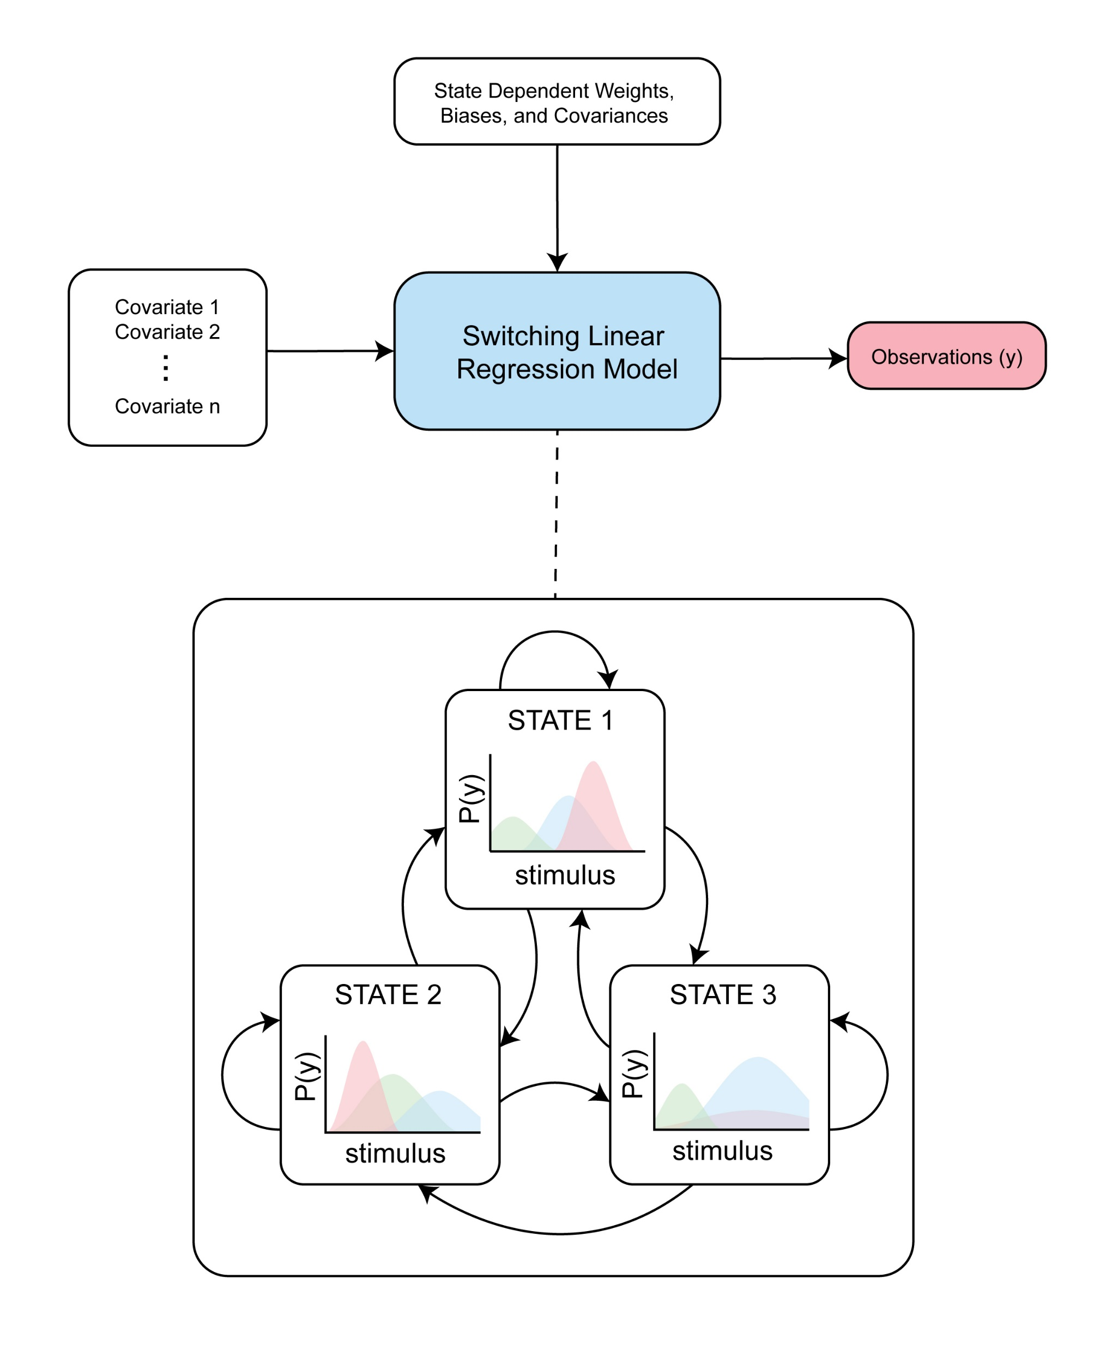

State Space Models to the rescue
Hidden Markov models (HMMs) are a special type of state-space model where the state are discrete, and the observations are generated from a conditional probability distribution given the current state.
Circular “vonMises” Distributions
It can be used to describe the evolution of observable events that depend on internal/external factors, which are not directly observable

Slide 12
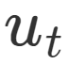
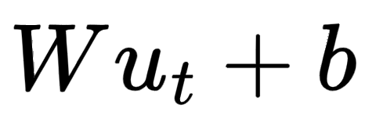
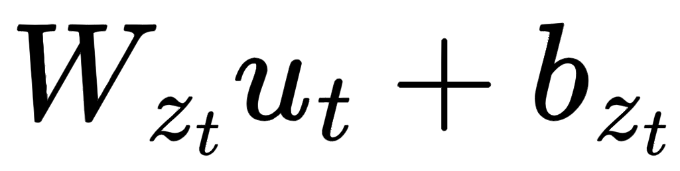

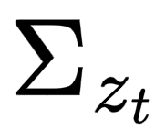
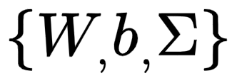
Modeling the circular emissions
Because of the circular nature of the emissions
Calibrated Target Angle
Coherence Level
Focused/Divided Attention
Expected Orientation
Vector of covariates
We will be modeling it in a Multivariate vonMises distribution
For location: (Linear regression with covariates)
However, weights and biases change for every state
Therefore, with state dependent weights and biases:
For concentration:
Are learnt parameters

Slide 13
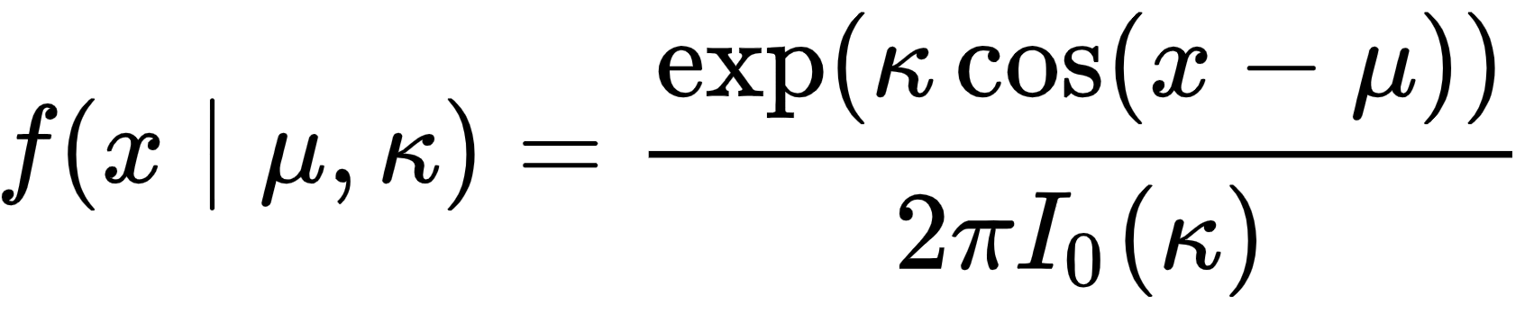
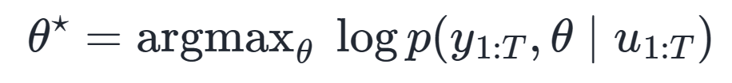
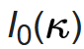
Model
Conceptual/goal:
MLE parameter estimate is learnt through Stochastic Gradient Descent (SGD) by minimizing negative of the marginal log probability
von Mises:
How:
where is the
modified Bessel function
Differentiation is automatically calculated through JAX’s AutoGrad

Slide 14
How to prep the features for the model
p( | )
Calibrated Target Angle
Coherence Level
Focused/Divided Attention
Expected Orientation
Presented target – Calibrated representation
High = 1, low = 0
Focused = 1, Divided = 0
Over-represented angle for that block
y
Bias of 1s (np.ones)
*For the model to project its “unaccounted” internal bias – analogous to Ashwood et al

Slide 15
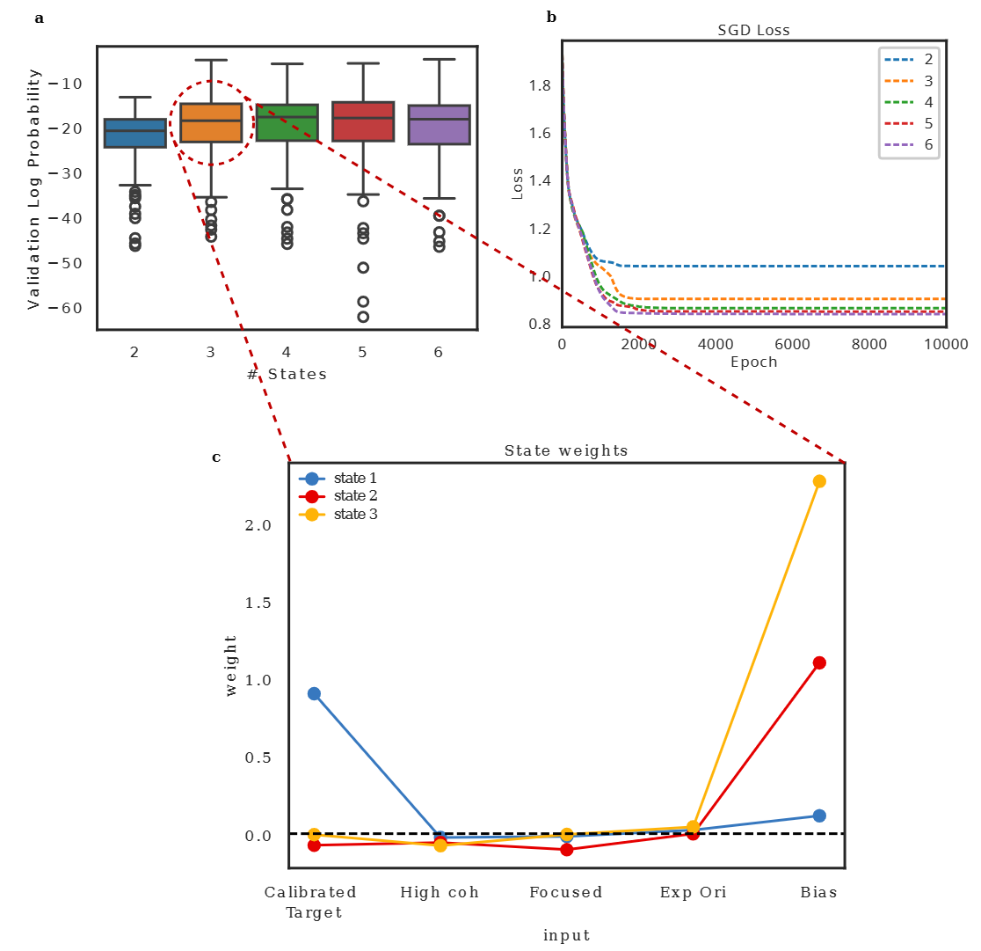
Which model to choose?
**
p value < 0.01
3 states model has the most significant difference in validation log probability while minimizing number of parameters

Slide 16
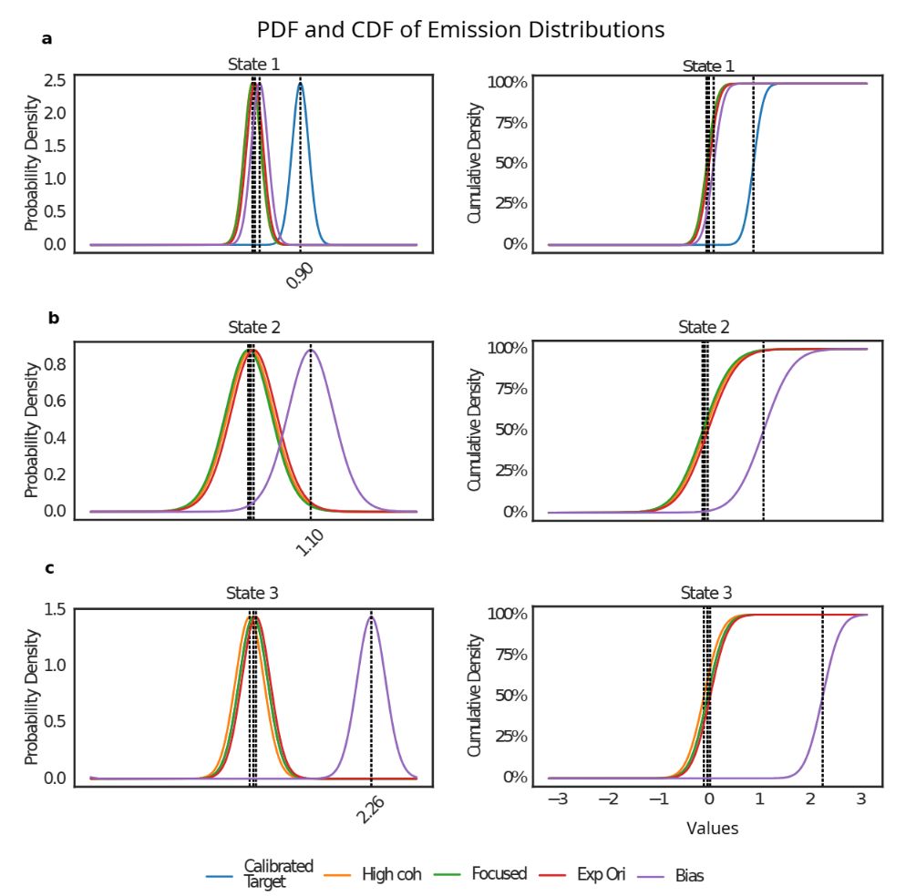
1 “Engaged” state & 2 “Biased” states
Characterizing inferred States

Slide 17
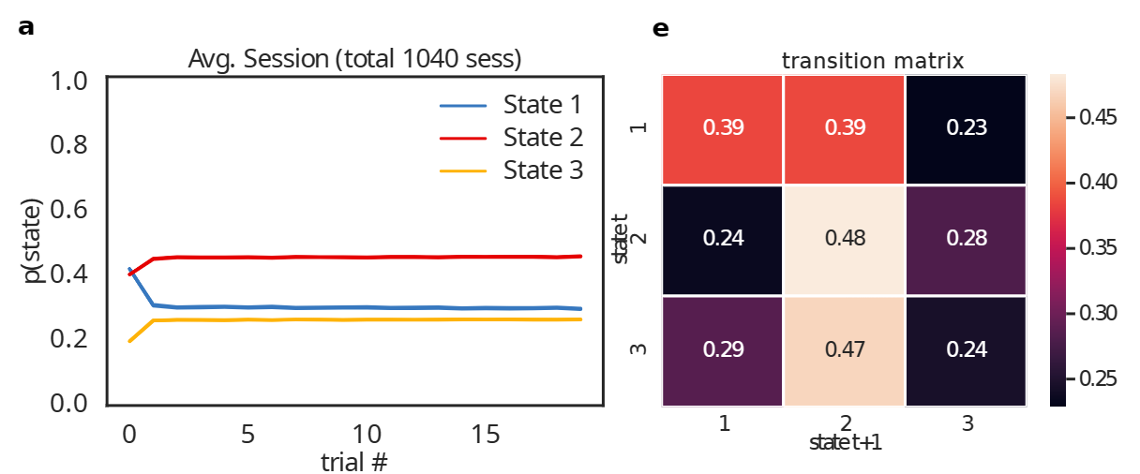
Subjects don’t change states often
*when looking across the entire subject population prob. of a given state across trials don’t change

Slide 18
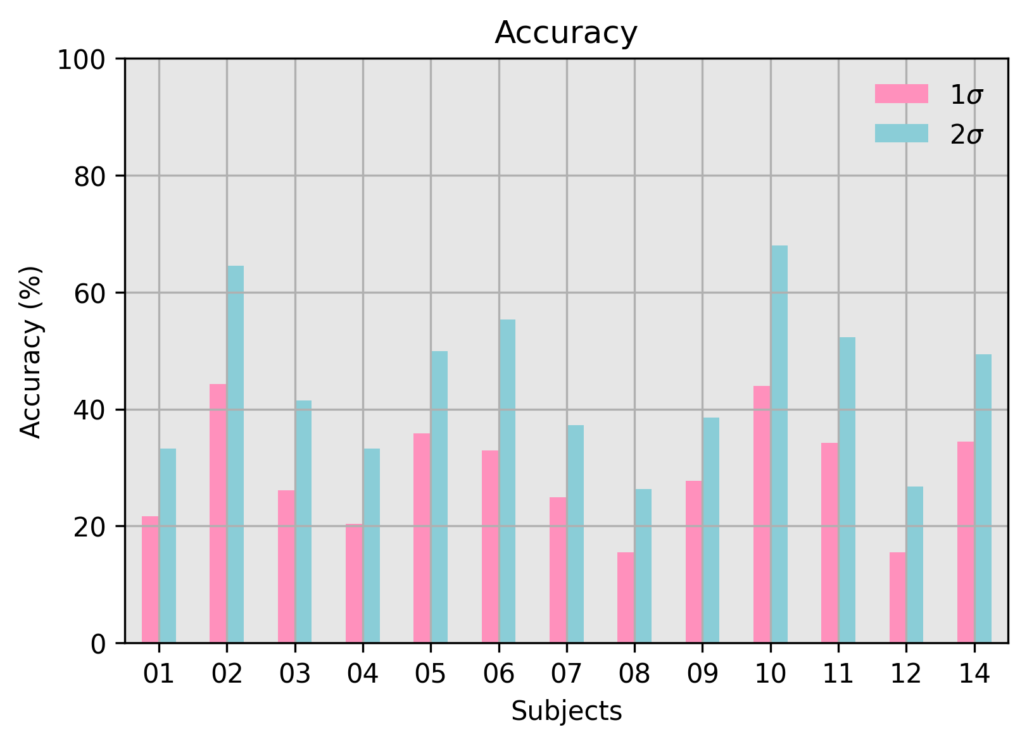

Slide 19
Thank you!

Slide 20
Appendix

Slide 21
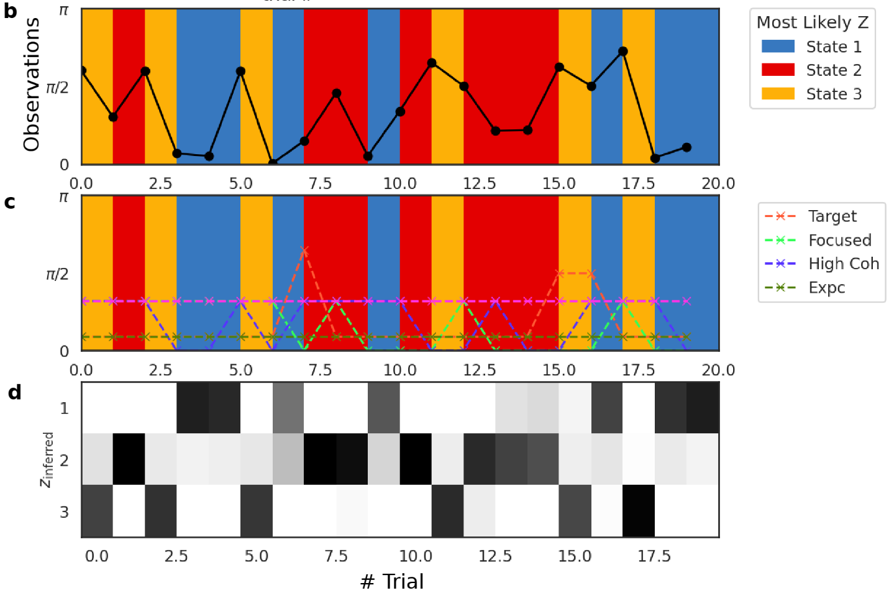
Single Example Session

Slide 22
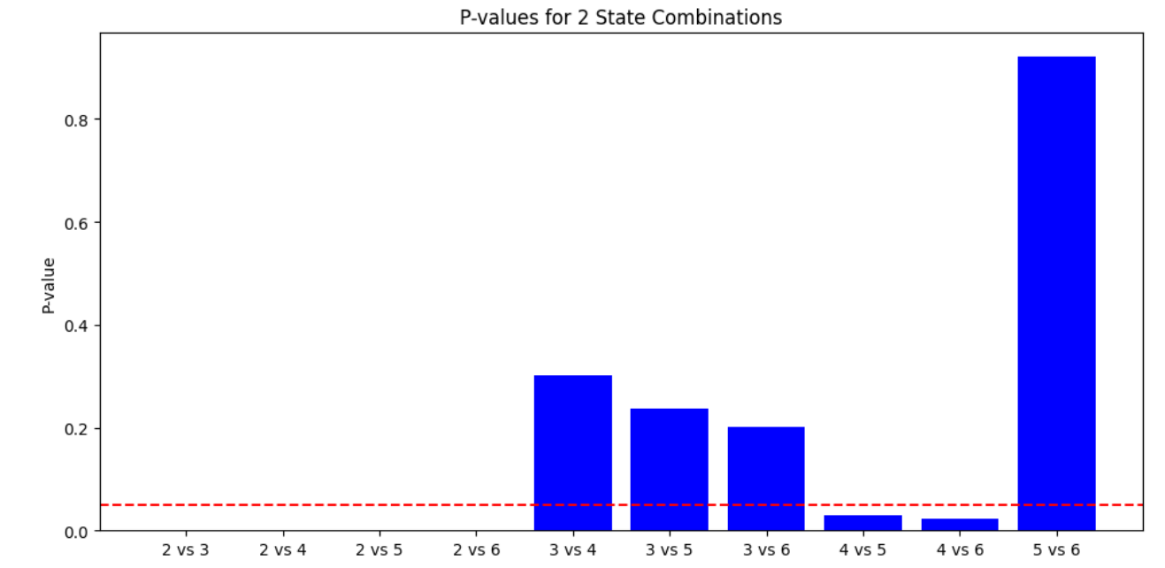
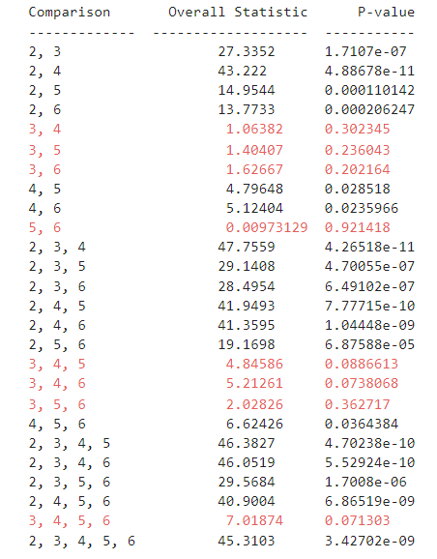
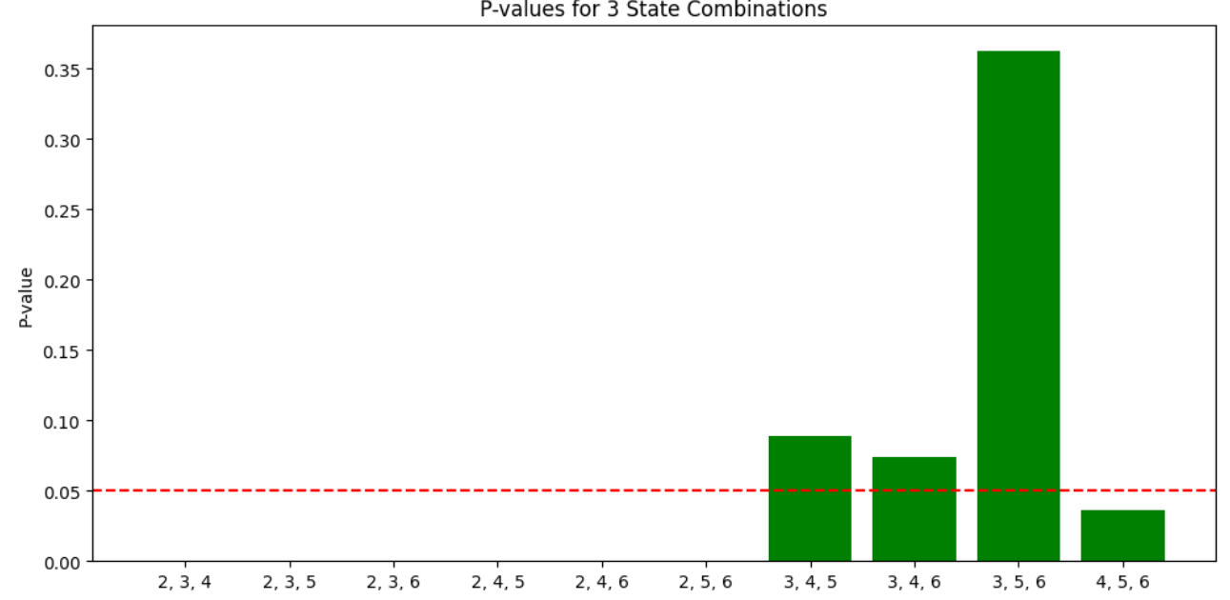
Stat testing results

